Slide 1

STUDENT
Ibukun-Oluwa Addy
SUPERVISOR
DR. Sampson Asare
A COMPARATIVE STUDY OF ARTIFICIAL INTELLIGENCE APPROACHES IN NUTRITION THERAPY
FOR GHANAIANS WITH SICKLE CELL DISEASE:
(TRADITIONAL EXPERT SYSTEMS VS LLM-AUGMENTED KG QUESTION ANSWERING)

Slide 2

WHAT IS THE PROBLEM?:
The Problem is a lack of intelligent NUTRITION ADVISORY SYSTEMS created to specifically cater to the needs of AFRICANS with sickle cell disease.
THIS THESIS IS UNDERSCORED BY THE THEORETICAL FRAMEWORK CALLED THE CHRONIC CARE MODEL.
Notes:
The Chronic Care Model (CCM), developed by Dr. Edward Wagner. Widely employed in managing conditions such as diabetes and hypertension, the CCM emphasizes continuity of personalized care and proactive management to enhance health outcomes. [1]

Slide 3

WHY IS THIS PROBLEM IMPORTANT?
80% of all sickle cell disease cases are concentrated in Africa, where poor nutritional choices have been identified as exacerbating factors that worsen the condition.

Slide 4
METHODOLOGY:
HOW WILL THIS PROJECT WORK?

Slide 5
COLLECT INFORMATION ABOUT FOODS AND THEIR COMPOUNDS AND NUTRITIONAL COMPOSITION.
DATA
COLLECT INFORMATION ABOUT SICKLE CELL DISEASE RECOMMENDED NUTRITIONAL ALLOWANCES, AND MEDICATION INTERACTIONS
DATA
COLLECT IMAGES OF AFRICAN MEALS
DATA

Slide 6
USE YOLO V8 API TO TRAIN A SIMPLE FOOD IMAGE RECOGNITION MODEL.
BASE
CREATE A KNOWLEDGE GRAPH WITH COLLECTED DATA AND PERFORM RAG ON AN LLM TO GENERATE REPORTS FOR A USER ABOUT WHAT OR WHEN TO EAT, USING NUTRITIONAL CONTENT DERIVED FROM THE MEAL IMAGE.
A.I APPROACH 1
USE CONDITIONAL PROGRAMMING TO GENERATE A SIMILAR REPORT FOR A USER.
A.I APPROACH 2

Slide 7
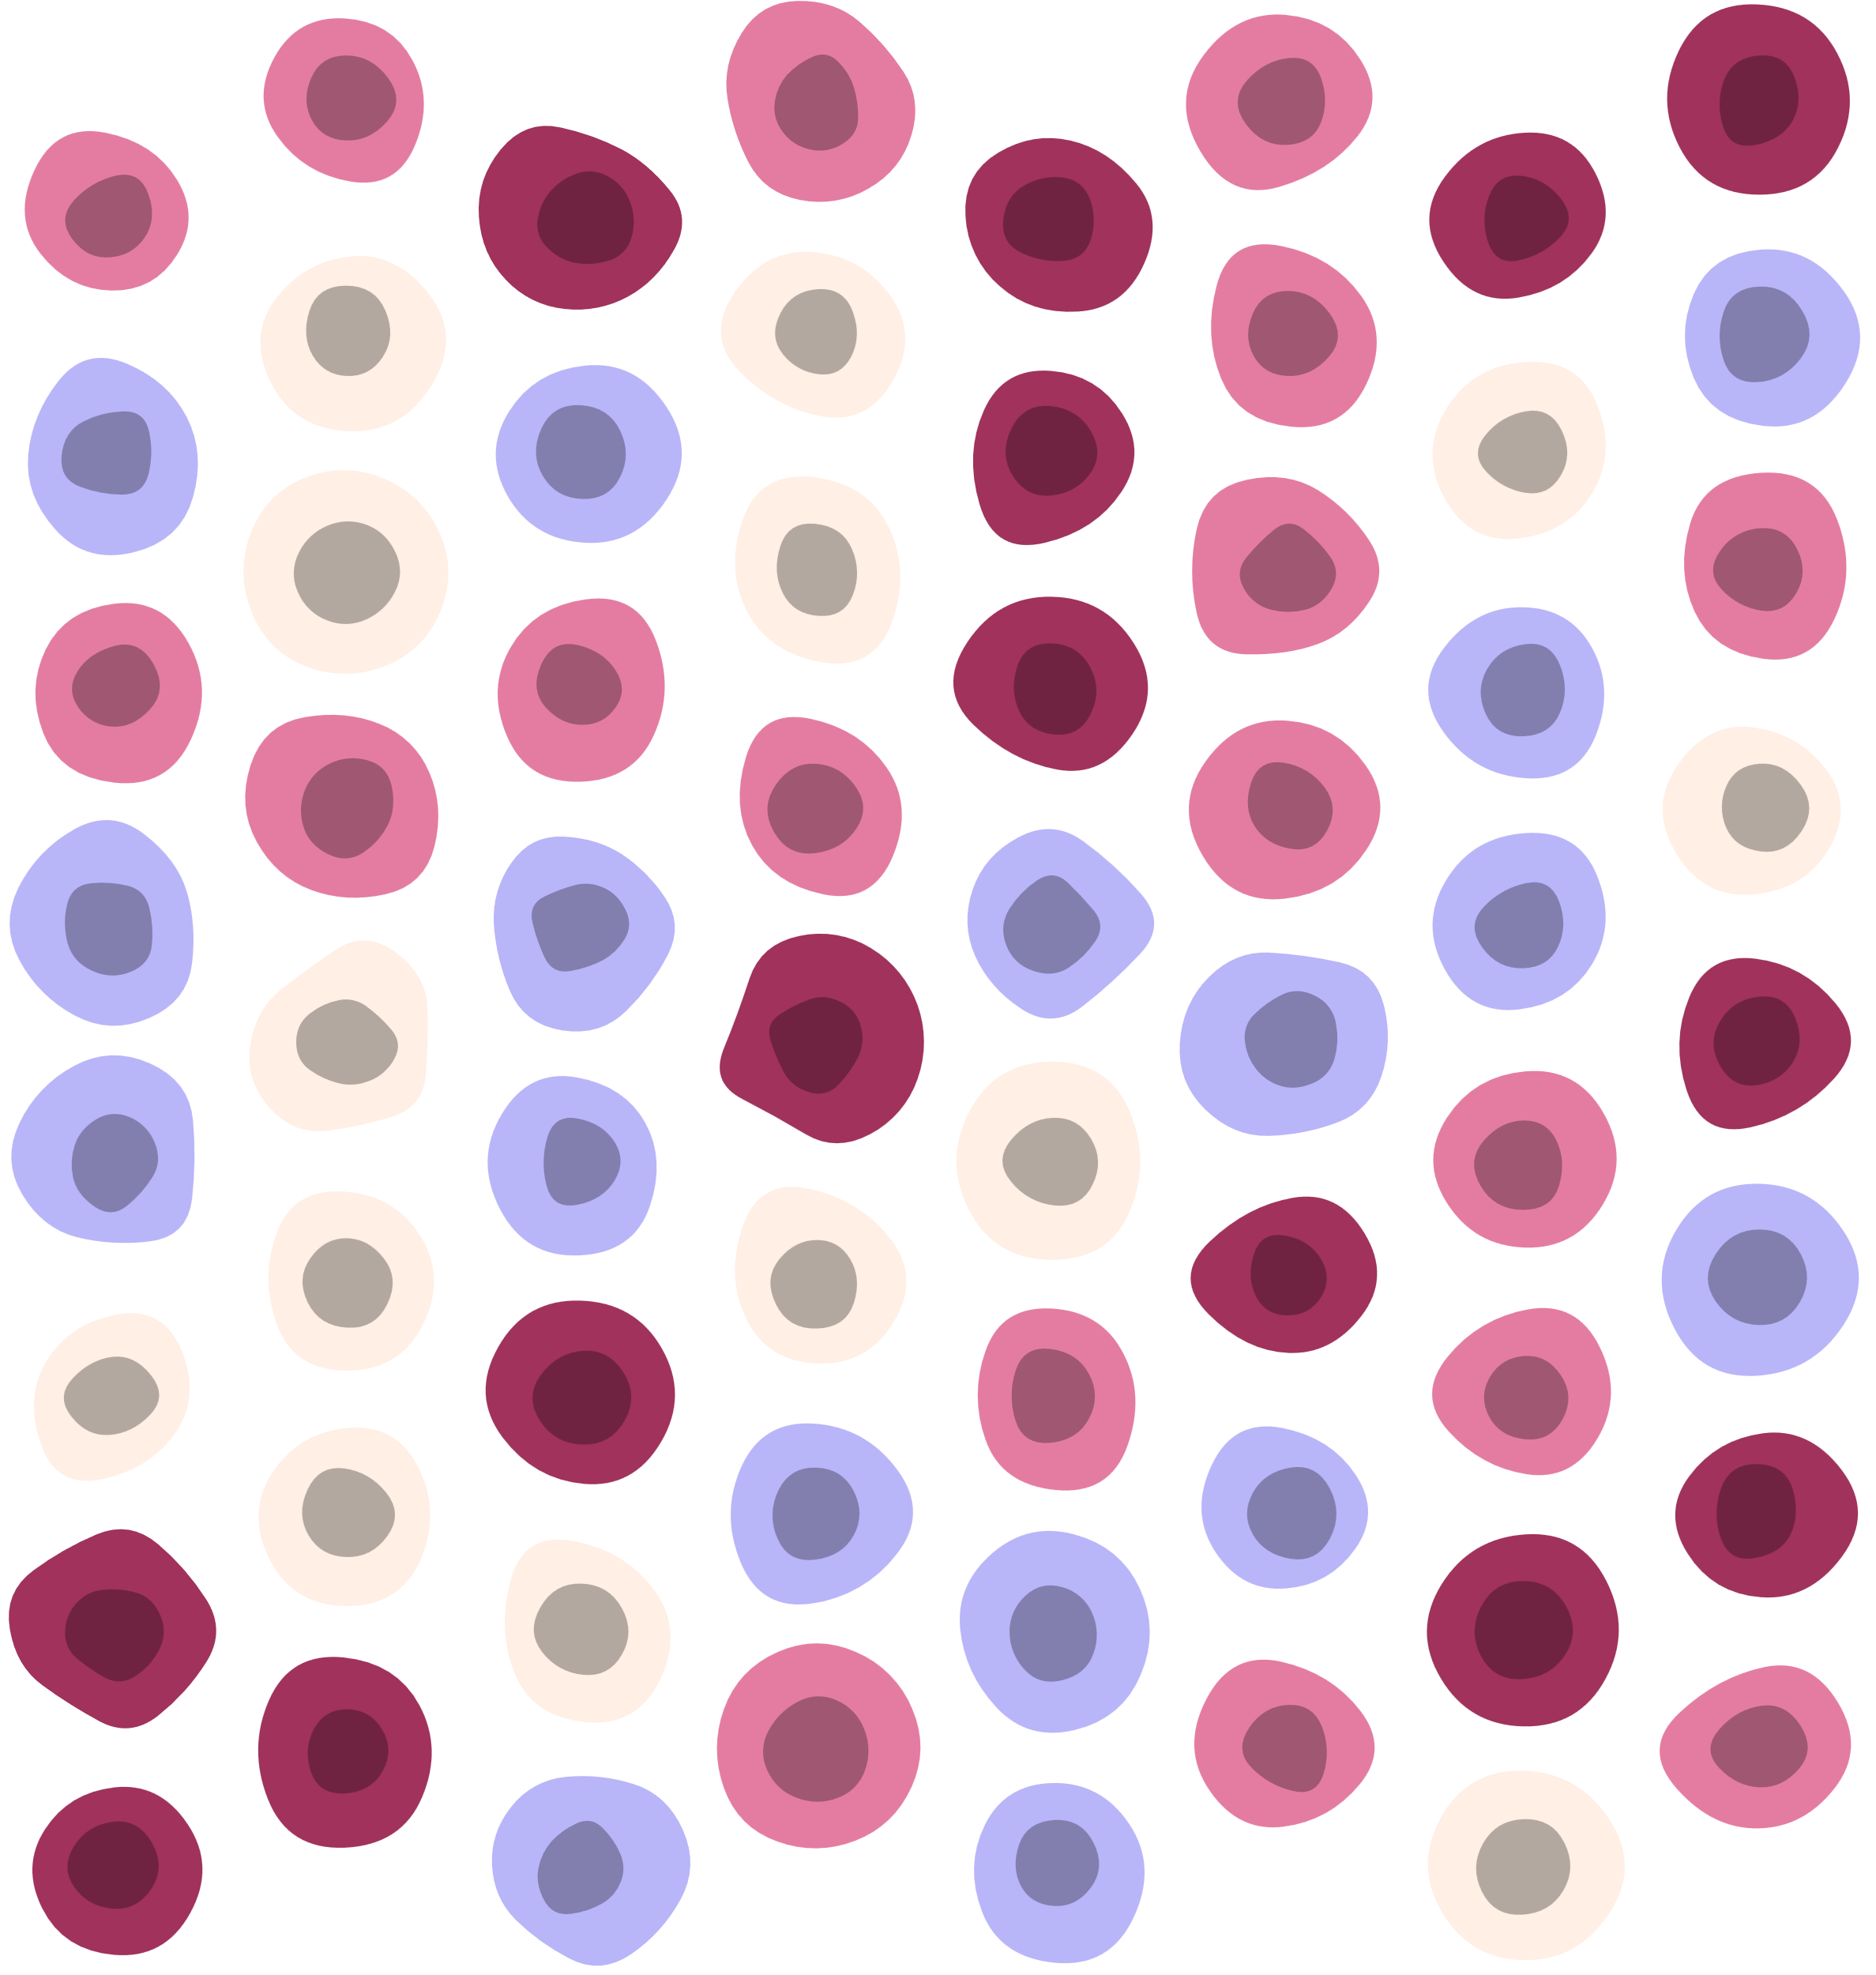
FINALLY
COMPARE THE REPORTS GENERATED BY THE RAG-LLM AND THE TRADITIONAL EXPERT SYSTEM USING A SEMANTIC LIBRARY.
DETERMINE SIMILARITIES AND DETERMINE WHICH GIVES A MORE ROBUST ADVISARY REPORT IN ORDER TO CONTRIBUTE TO THE BODY OF KNOWLEDGE.

Slide 8
PROGRESS
BUILT A SMALL KNOWLEDGE GRAPH TO TEST THE LLM CONCEPT WITH DUMMY DATA.
ALL REAL DATA HAS BEEN COLLECTED

